Slide 1
PopulationSim Training 1
December 5th, 2023
Kaelem Mohabir, Alex Bettinardi
Notes:
Good afternoon everyone, my name is Kaelem Mohabir. I’m a transportation modeler and analyst in TPAU.
Thanks so much for joining us. This training is going to focus on using PopulationSim. Most of what we’re looking at was work Alex and I did over the past few months to run PopulationSim for the full state of Oregon.
The training is split into two parts, and we’ll be recording each session. All of the material we’re looking at should be accessible from the email Alex sent out last Friday. I will take us through the slides and then we’ll hopefully have time for questions at the end.

Slide 2
Training Overview
Training 1
Census Data
TidyCensus R Package
2020 Decennial Data
2021 ACS5 Data
Pulling necessary Data
Processing and Balancing Input Data for PopulationSim
Building Controls and Geography Crosswalk
Training 2
PopulationSim Folder Structure
Seed Processor
Running PopulationSim
Outputs
Validation
Overview of Differences in Group Quarters Processing
Notes:
There are a lot of somewhat finnicky pieces to get in place before running but the overall process for PopulationSim can be broken down into 5 simple steps:
The first is the Software setup, getting the PopulationSim installed-> the second is Pulling the necessary census data -> the third is matching up the census data to the same geographies and totals -> the fourth is running the software -> and then the fifth and last step is interpreting the outputs
Here we can see an overall roadmap of our training sessions.
In this first session we’ll focus on pulling the census data, getting input data cleaned and ready, and then building the controls and making sure the different geographies nest correctly

Slide 3
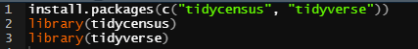
TidyCensus
Free R package created to interface with Census APIs
Returns tidyverse ready data frames
Simple to install and use
Notes:
So in order to do this work and pull the necessary data from census, we heavily relied on TidyCensus
TidyCensus is an R package created to interface with Census APIs
Census APIs are The Census Data Application Programming Interfaces (API)
And they give the public access to raw statistical data from Census data programs
TidyCensus works with the tidyverse package
Pretty easy to use, here’s a snippet of code showing the install and library commands

Slide 4
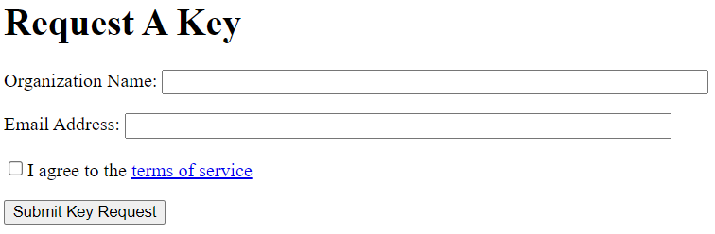
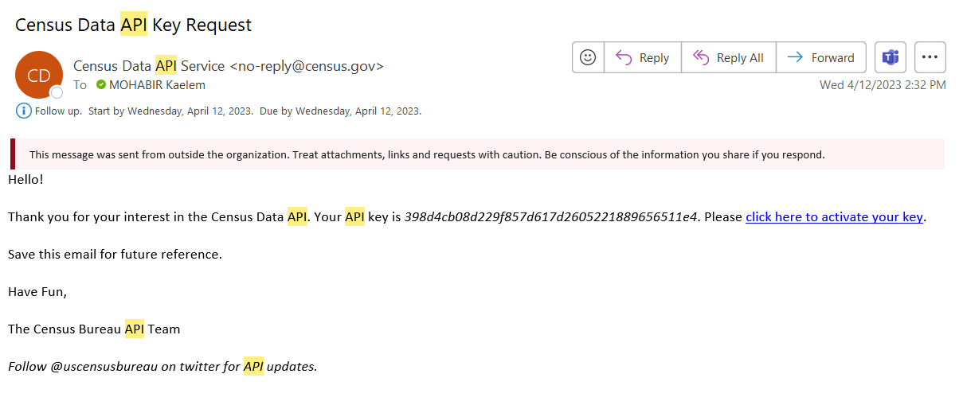
Census API Key
https://api.census.gov/data/key_signup.html
census_api_key("YOUR KEY GOES HERE", install = TRUE)
Notes:
You need a census API key to use the package
Incredibly simple to get one
Go to the linked website in the first bullet and signup with your org name and email
Within 30ish minutes they’ll send you a key
The second bullet shows the line of code to install the key in R,
Sets key as an environment variable in R environ
The screenshots on this slide show the key request form and the email they send with the key

Slide 5
Tidycensus Functions
Two major functions
get_decennial()
Grants access to 2000, 2010, 2020 decennial US Census APIs
get_acs()
Grants access to 1-year and 5-year American Community Survey APIs
Specify geography, year, and variable(s)
Returns tibble with data for specified variables
Notes:
So tidycensus has two major functions in it
One pulls decennial census data
The other pulls from American Community survey data
You need input geography, year and variable you’re requesting data for and a tibble will be returned

Slide 6
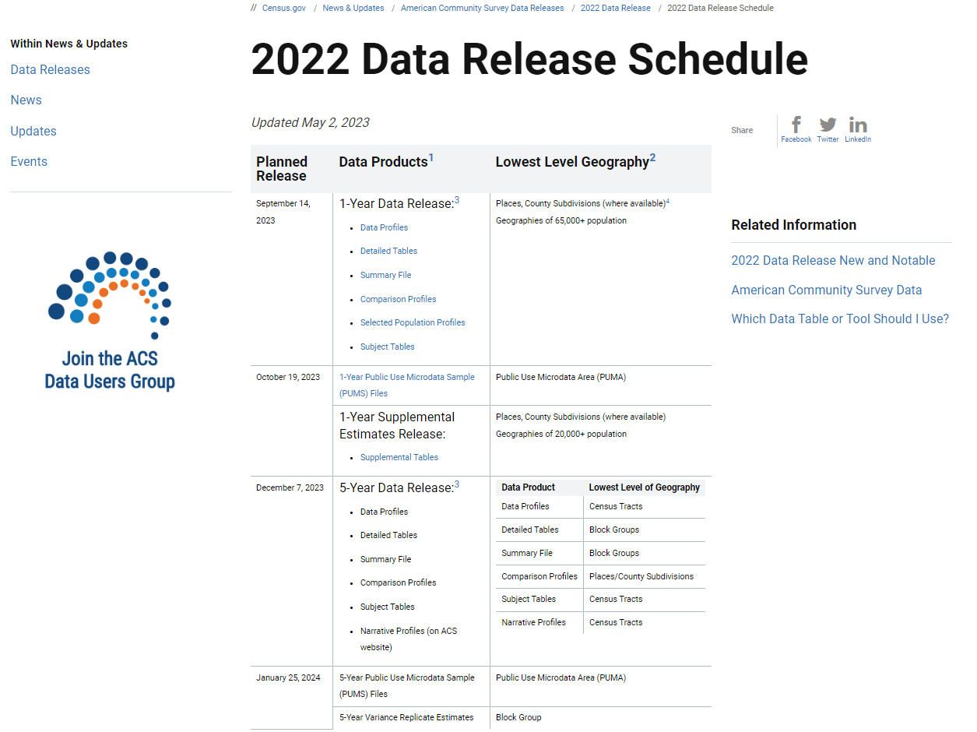
ACS5 2022 Data Release Schedule
Table ID | Line | Unique ID | Stub | Data Release
B01001 |  |  | SEX BY AGE | 1,5
B01001 |  |  | Universe: Total population
B01001 | 1 | B01001_001 | Total:
B01001 | 2 | B01001_002 | Male:
B01001 | 3 | B01001_003 | Under 5 years
B01001 | 4 | B01001_004 | 5 to 9 years
B01001 | 5 | B01001_005 | 10 to 14 years
B01001 | 6 | B01001_006 | 15 to 17 years
B01001 | 7 | B01001_007 | 18 and 19 years
B01001 | 8 | B01001_008 | 20 years
B01001 | 9 | B01001_009 | 21 years
B01001 | 10 | B01001_010 | 22 to 24 years
B01001 | 11 | B01001_011 | 25 to 29 years
B01001 | 12 | B01001_012 | 30 to 34 years
B01001 | 13 | B01001_013 | 35 to 39 years
B01001 | 14 | B01001_014 | 40 to 44 years
B01001 | 15 | B01001_015 | 45 to 49 years
B01001 | 16 | B01001_016 | 50 to 54 years
B01001 | 17 | B01001_017 | 55 to 59 years
B01001 | 18 | B01001_018 | 60 and 61 years
B01001 | 19 | B01001_019 | 62 to 64 years
B01001 | 20 | B01001_020 | 65 and 66 years
B01001 | 21 | B01001_021 | 67 to 69 years
B01001 | 22 | B01001_022 | 70 to 74 years
B01001 | 23 | B01001_023 | 75 to 79 years
B01001 | 24 | B01001_024 | 80 to 84 years
B01001 | 25 | B01001_025 | 85 years and over
B01001 | 26 | B01001_026 | Female:
B01001 | 27 | B01001_027 | Under 5 years
B01001 | 28 | B01001_028 | 5 to 9 years
B01001 | 29 | B01001_029 | 10 to 14 years
B01001 | 30 | B01001_030 | 15 to 17 years
B01001 | 31 | B01001_031 | 18 and 19 years
B01001 | 32 | B01001_032 | 20 years
B01001 | 33 | B01001_033 | 21 years
B01001 | 34 | B01001_034 | 22 to 24 years
B01001 | 35 | B01001_035 | 25 to 29 years
B01001 | 36 | B01001_036 | 30 to 34 years
B01001 | 37 | B01001_037 | 35 to 39 years
B01001 | 38 | B01001_038 | 40 to 44 years
B01001 | 39 | B01001_039 | 45 to 49 years
B01001 | 40 | B01001_040 | 50 to 54 years
B01001 | 41 | B01001_041 | 55 to 59 years
B01001 | 42 | B01001_042 | 60 and 61 years
B01001 | 43 | B01001_043 | 62 to 64 years
B01001 | 44 | B01001_044 | 65 and 66 years
B01001 | 45 | B01001_045 | 67 to 69 years
B01001 | 46 | B01001_046 | 70 to 74 years
B01001 | 47 | B01001_047 | 75 to 79 years
B01001 | 48 | B01001_048 | 80 to 84 years
B01001 | 49 | B01001_049 | 85 years and over
Notes:
A quick note here about the ACS data.
We used the 2017-2021 ACS5 data and that’s what we’ll be looking at today. That is currently the newest data available.
In a couple of days, on the 7th, the 2018-2022 data will be released and I’ll be updating the data accordingly.

Slide 7
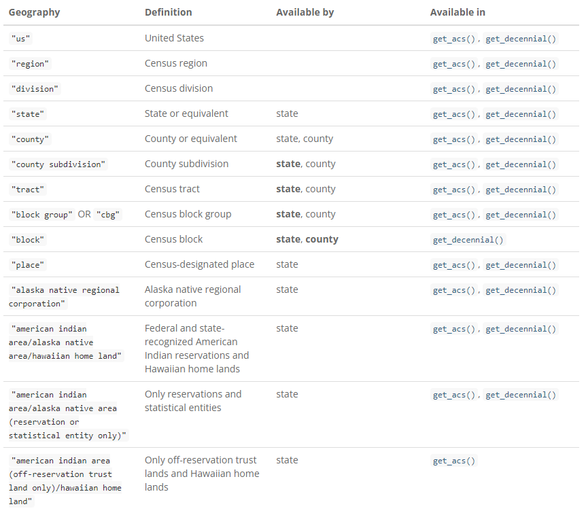
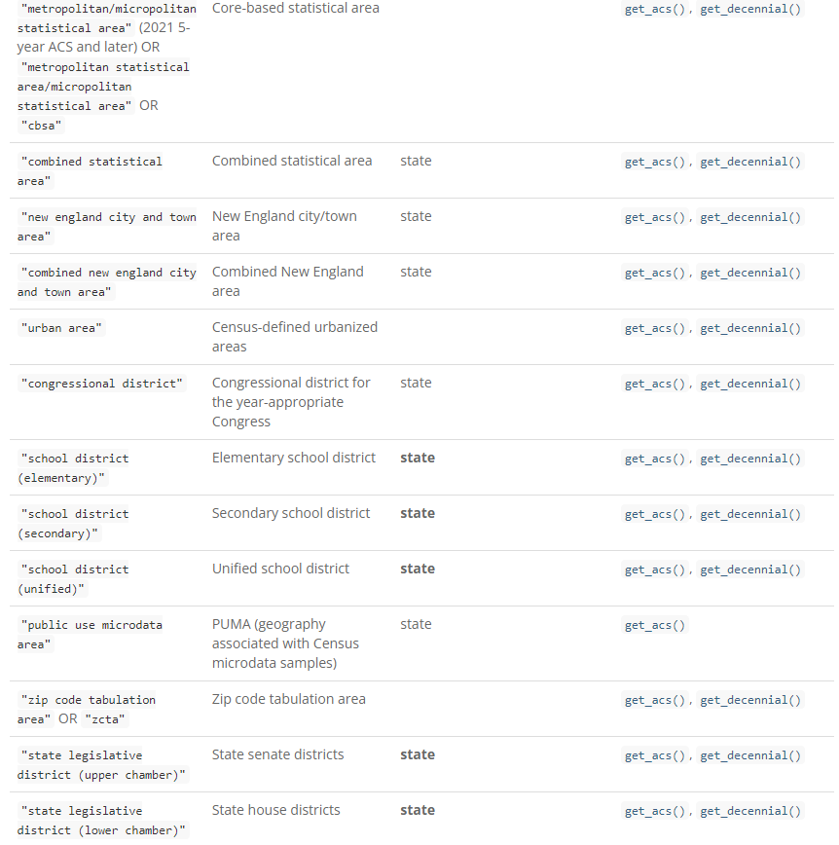
Available Geographies
Notes:
Here are all of the geographies available in Tidycensus, and the functions they are available for
If we look at block level geography we can see that it is only available for the get_decennial() function and not the get_acs_function()

Slide 8
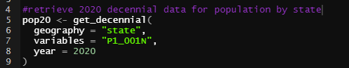
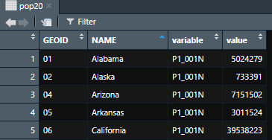
2020 Census Data
get_decennial() function pulls data from census
Required arguments are geography, year, and variable(s)
Notes:
Here’s a very simple example showing the get decennial function.
Geography is specified by state, the variable is population, and the year is 2020.
The bottom shows the first five rows of the output. P1_001N is the total number of people

Slide 9
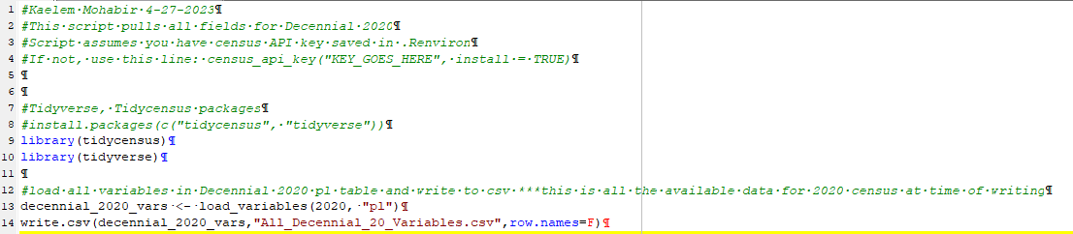
Pulling 2020 Decennial Variables
Script to pull all variables in 2020 Decennial Census
Notes:
PL (Public Law) 94-171 Redistricting Data is the only available table for the 2020 decennial
This slide shows a simple script to pull all variables in 2020 Decennial Census and write them out to a csv

Slide 10
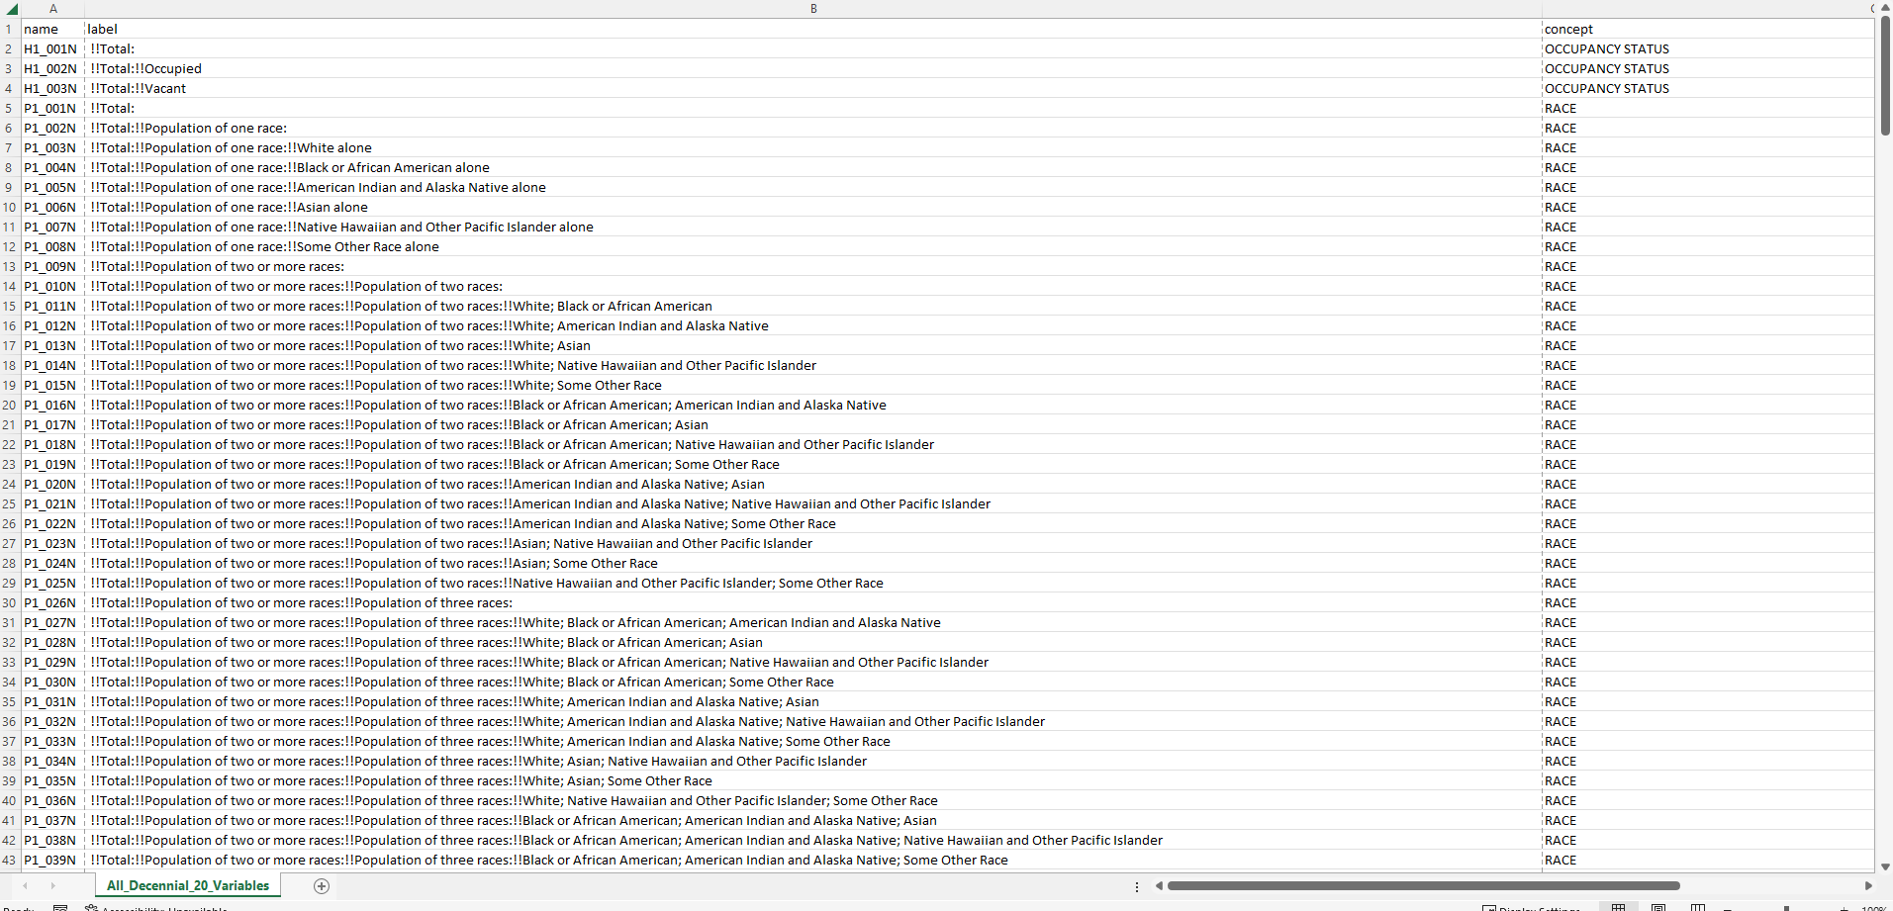
2020 Decennial Variables
All 2020 Decennial Variables (301)
Notes:
Here we can see the output csv with all the variables in the 2020 census
There are 301 variables in total for the 2020 Decennial
So the process is to pull out all the variables, Identify those you want, and then pull the data for those variables you’ve selected

Slide 11
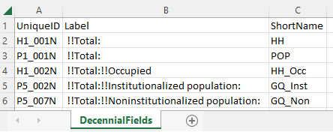
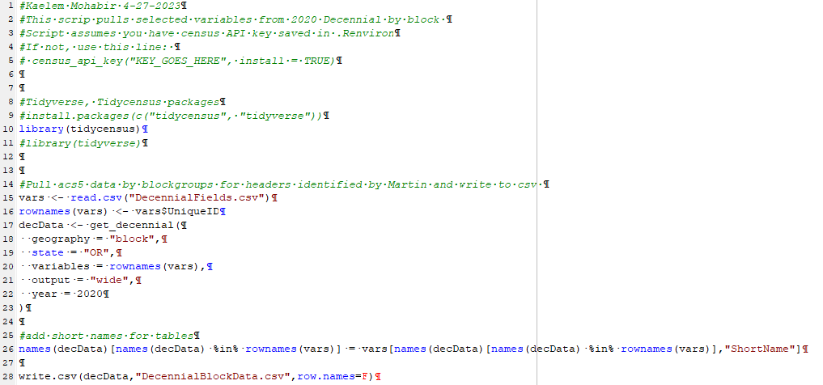
Selected Decennial Variables
Selected variables CSV (5)
Script to pull data for selected variables
Notes:
On the left is a separate spreadsheet with the variables I want data for. From the 301 we saw last slide, I’ve isolated the 5 on interest to me and written shorthand names for them
On the right is the script to pull the data for these 5 variables
You specify geography to pull for, here on line 18 it’s specified as block
Specifying the output as wide on line 21 flattens the data in the output csv
I’m renaming the variables to our shortnames on line 26
And then finally writing out a csv with data

Slide 12
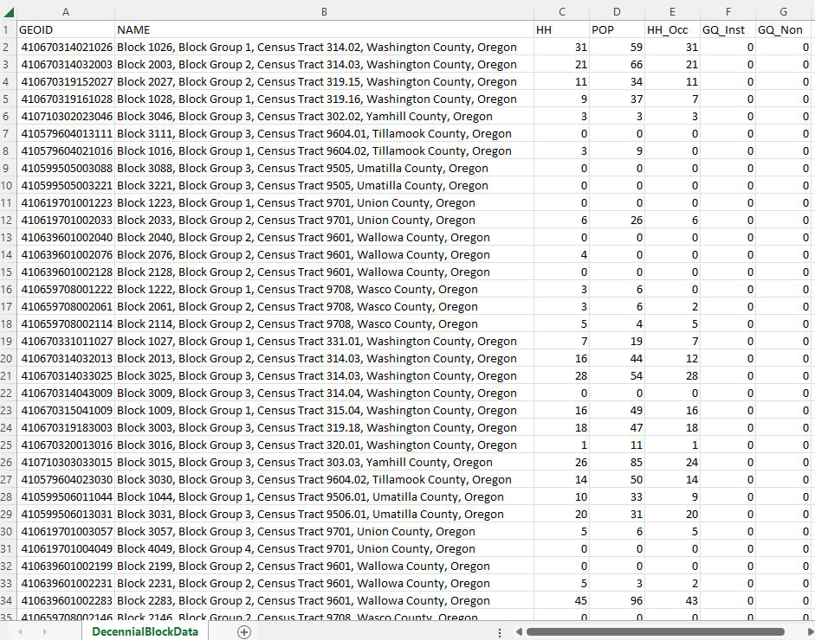
Selected Decennial Data
2020 Decennial data by block group for specified variables CSV
Notes:
Here is the output CSV with the data for the 5 variables I selected to pull for. Each row represents an individual block geography

Slide 13
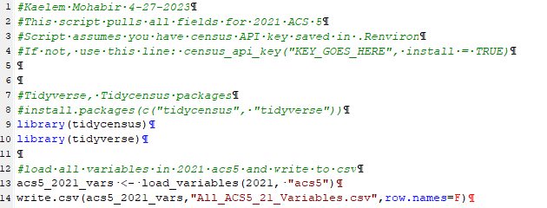
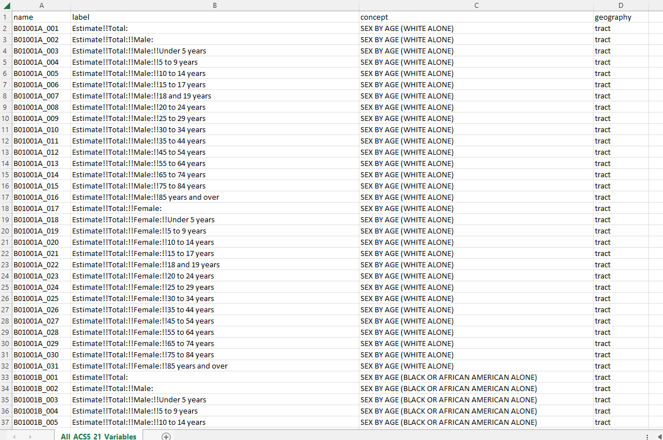
2021 ACS 5 Variables
Script to pull all variables in 2021 ACS5
Output CSV with all ACS5 variables (27,886)
Notes:
Now, moving onto ACS data.
This slide shows pulling data from the ACS5.
On the left is the script to pull all of the ACS5 variables and write them out to a csv
On right is the output csv with all variables
The ACS has a lot more variables to work with than decennial
There are almost 28,000 here, which can make finding variables much more challenging than in the decennial with the 301 variables.

Slide 14
ACS5 Table B01001 Sex by Age
Table ID | Line | Unique ID | Stub | Data Release
B01001 |  |  | SEX BY AGE | 1,5
B01001 |  |  | Universe: Total population
B01001 | 1 | B01001_001 | Total:
B01001 | 2 | B01001_002 | Male:
B01001 | 3 | B01001_003 | Under 5 years
B01001 | 4 | B01001_004 | 5 to 9 years
B01001 | 5 | B01001_005 | 10 to 14 years
B01001 | 6 | B01001_006 | 15 to 17 years
B01001 | 7 | B01001_007 | 18 and 19 years
B01001 | 8 | B01001_008 | 20 years
B01001 | 9 | B01001_009 | 21 years
B01001 | 10 | B01001_010 | 22 to 24 years
B01001 | 11 | B01001_011 | 25 to 29 years
B01001 | 12 | B01001_012 | 30 to 34 years
B01001 | 13 | B01001_013 | 35 to 39 years
B01001 | 14 | B01001_014 | 40 to 44 years
B01001 | 15 | B01001_015 | 45 to 49 years
B01001 | 16 | B01001_016 | 50 to 54 years
B01001 | 17 | B01001_017 | 55 to 59 years
B01001 | 18 | B01001_018 | 60 and 61 years
B01001 | 19 | B01001_019 | 62 to 64 years
B01001 | 20 | B01001_020 | 65 and 66 years
B01001 | 21 | B01001_021 | 67 to 69 years
B01001 | 22 | B01001_022 | 70 to 74 years
B01001 | 23 | B01001_023 | 75 to 79 years
B01001 | 24 | B01001_024 | 80 to 84 years
B01001 | 25 | B01001_025 | 85 years and over
B01001 | 26 | B01001_026 | Female:
B01001 | 27 | B01001_027 | Under 5 years
B01001 | 28 | B01001_028 | 5 to 9 years
B01001 | 29 | B01001_029 | 10 to 14 years
B01001 | 30 | B01001_030 | 15 to 17 years
B01001 | 31 | B01001_031 | 18 and 19 years
B01001 | 32 | B01001_032 | 20 years
B01001 | 33 | B01001_033 | 21 years
B01001 | 34 | B01001_034 | 22 to 24 years
B01001 | 35 | B01001_035 | 25 to 29 years
B01001 | 36 | B01001_036 | 30 to 34 years
B01001 | 37 | B01001_037 | 35 to 39 years
B01001 | 38 | B01001_038 | 40 to 44 years
B01001 | 39 | B01001_039 | 45 to 49 years
B01001 | 40 | B01001_040 | 50 to 54 years
B01001 | 41 | B01001_041 | 55 to 59 years
B01001 | 42 | B01001_042 | 60 and 61 years
B01001 | 43 | B01001_043 | 62 to 64 years
B01001 | 44 | B01001_044 | 65 and 66 years
B01001 | 45 | B01001_045 | 67 to 69 years
B01001 | 46 | B01001_046 | 70 to 74 years
B01001 | 47 | B01001_047 | 75 to 79 years
B01001 | 48 | B01001_048 | 80 to 84 years
B01001 | 49 | B01001_049 | 85 years and over
Notes:
Through the next few slides we’re going to be looking at the data that we were interested in from the ACS5.
We ended up pulling around 120 variables out vs the 5 from the decennial.
Again, figuring out what to pull here is a bit challenging. There’s a table shells excel spreadsheet in the training folder from census that breaks down the tables that each variable is contained it which can be helpful to help sort through.
Applying filters on the spreadsheet with the full 28,000 variable and filtering on geography and using key word searches can also work well.
On this slide we have the Sex by Age table which breaks down the total population by gender into age categories
On the top here you can see Census lists the Universe as Total population. This means the table sums to that for the relevant geography. We’ll see different universes in a minute

Slide 15
ACS5 Table B11016 Household Type by Household Size
Table ID | Line | Unique ID | Stub | Data Release
B11016 |  |  | HOUSEHOLD TYPE BY HOUSEHOLD SIZE | 1,5
B11016 |  |  | Universe: Households
B11016 | 1 | B11016_001 | Total:
B11016 | 2 | B11016_002 | Family households:
B11016 | 3 | B11016_003 | 2-person household
B11016 | 4 | B11016_004 | 3-person household
B11016 | 5 | B11016_005 | 4-person household
B11016 | 6 | B11016_006 | 5-person household
B11016 | 7 | B11016_007 | 6-person household
B11016 | 8 | B11016_008 | 7-or-more person household
B11016 | 9 | B11016_009 | Nonfamily households:
B11016 | 10 | B11016_010 | 1-person household
B11016 | 11 | B11016_011 | 2-person household
B11016 | 12 | B11016_012 | 3-person household
B11016 | 13 | B11016_013 | 4-person household
B11016 | 14 | B11016_014 | 5-person household
B11016 | 15 | B11016_015 | 6-person household
B11016 | 16 | B11016_016 | 7-or-more person household
ACS5 Table B25004 Vacancy Status
Table ID | Line | Unique ID | Stub | Data Release
B25004 |  |  | VACANCY STATUS | 1,5
B25004 |  |  | Universe: Vacant housing units
B25004 | 1 | B25004_001 | Total:
B25004 | 2 | B25004_002 | For rent
B25004 | 3 | B25004_003 | Rented, not occupied
B25004 | 4 | B25004_004 | For sale only
B25004 | 5 | B25004_005 | Sold, not occupied
B25004 | 6 | B25004_006 | For seasonal, recreational, or occasional use
B25004 | 7 | B25004_007 | For migrant workers
B25004 | 8 | B25004_008 | Other vacant
Notes:
On this slide we have Household type by household size.
This universe is households, so the table total will be the total number of households in the geography.
Vacancy Status totals to vacant housing units (the universe)

Slide 16
ACS5 Table B19001 Household Income in the past 12 months (Adjusted)
Table ID | Line | Unique ID | Stub | Data Release
B19001 |  |  | HOUSEHOLD INCOME IN THE PAST 12 MONTHS (IN 2020 INFLATION-ADJUSTED DOLLARS) | 1,5
B19001 |  |  | Universe: Households
B19001 | 1 | B19001_001 | Total:
B19001 | 2 | B19001_002 | Less than $10,000
B19001 | 3 | B19001_003 | $10,000 to $14,999
B19001 | 4 | B19001_004 | $15,000 to $19,999
B19001 | 5 | B19001_005 | $20,000 to $24,999
B19001 | 6 | B19001_006 | $25,000 to $29,999
B19001 | 7 | B19001_007 | $30,000 to $34,999
B19001 | 8 | B19001_008 | $35,000 to $39,999
B19001 | 9 | B19001_009 | $40,000 to $44,999
B19001 | 10 | B19001_010 | $45,000 to $49,999
B19001 | 11 | B19001_011 | $50,000 to $59,999
B19001 | 12 | B19001_012 | $60,000 to $74,999
B19001 | 13 | B19001_013 | $75,000 to $99,999
B19001 | 14 | B19001_014 | $100,000 to $124,999
B19001 | 15 | B19001_015 | $125,000 to $149,999
B19001 | 16 | B19001_016 | $150,000 to $199,999
B19001 | 17 | B19001_017 | $200,000 or more
Notes:
The universe here is households for adjusted household income

Slide 17
ACS5 Table B01003 Total Population
Table ID | Line | Unique ID | Stub | Data Release
B01003 |  |  | TOTAL POPULATION | 1,5
B01003 |  |  | Universe: Total population
B01003 | 1 | B01003_001 | Total
ACS5 Table B0019 Household Type by Relationship
Table ID | Line | Unique ID | Stub | Data Release
B09019 |  |  | HOUSEHOLD TYPE (INCLUDING LIVING ALONE) BY RELATIONSHIP | 1,5
B09019 |  |  | Universe: Total population
B09019 | 1 | B09019_001 | Total:
B09019 | 2 | B09019_002 | In households:
B09019 | 26 | B09019_026 | In group quarters
ACS5 Table B25024 Units in Structure
Table ID | Line | Unique ID | Stub | Data Release
B25024 |  |  | UNITS IN STRUCTURE | 1,5
B25024 |  |  | Universe: Housing units
B25024 | 1 | B25024_001 | Total:
B25024 | 2 | B25024_002 | 1, detached
B25024 | 3 | B25024_003 | 1, attached
B25024 | 4 | B25024_004 | 2
B25024 | 5 | B25024_005 | 3 or 4
B25024 | 6 | B25024_006 | 5 to 9
B25024 | 7 | B25024_007 | 10 to 19
B25024 | 8 | B25024_008 | 20 to 49
B25024 | 9 | B25024_009 | 50 or more
B25024 | 10 | B25024_010 | Mobile home
B25024 | 11 | B25024_011 | Boat, RV, van, etc.
Notes:
Total population Is just the total population.
Household type totals to total population
Units in structure totals to housing unites

Slide 18
ACS5 Table B25044 Tenure by Vehicles Available
Table ID | Line | Unique ID | Stub | Data Release
B25044 |  |  | TENURE BY VEHICLES AVAILABLE | 1,5
B25044 |  |  | Universe: Occupied housing units
B25044 | 1 | B25044_001 | Total:
B25044 | 2 | B25044_002 | Owner occupied:
B25044 | 3 | B25044_003 | No vehicle available
B25044 | 4 | B25044_004 | 1 vehicle available
B25044 | 5 | B25044_005 | 2 vehicles available
B25044 | 6 | B25044_006 | 3 vehicles available
B25044 | 7 | B25044_007 | 4 vehicles available
B25044 | 8 | B25044_008 | 5 or more vehicles available
B25044 | 9 | B25044_009 | Renter occupied:
B25044 | 10 | B25044_010 | No vehicle available
B25044 | 11 | B25044_011 | 1 vehicle available
B25044 | 12 | B25044_012 | 2 vehicles available
B25044 | 13 | B25044_013 | 3 vehicles available
B25044 | 14 | B25044_014 | 4 vehicles available
B25044 | 15 | B25044_015 | 5 or more vehicles available
ACS5 Table B25004 Vacancy Status
Table ID | Line | Unique ID | Stub | Data Release
B25004 |  |  | VACANCY STATUS | 1,5
B25004 |  |  | Universe: Vacant housing units
B25004 | 1 | B25004_001 | Total:
B25004 | 2 | B25004_002 | For rent
B25004 | 3 | B25004_003 | Rented, not occupied
B25004 | 4 | B25004_004 | For sale only
B25004 | 5 | B25004_005 | Sold, not occupied
B25004 | 6 | B25004_006 | For seasonal, recreational, or occasional use
B25004 | 7 | B25004_007 | For migrant workers
B25004 | 8 | B25004_008 | Other vacant
Notes:
Number of vehicles totals to occupied housing units
Vacancy status totals to vacant housing units

Slide 19
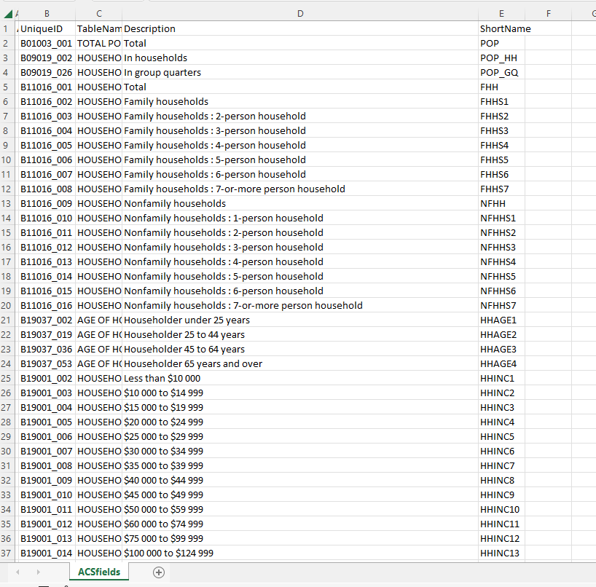
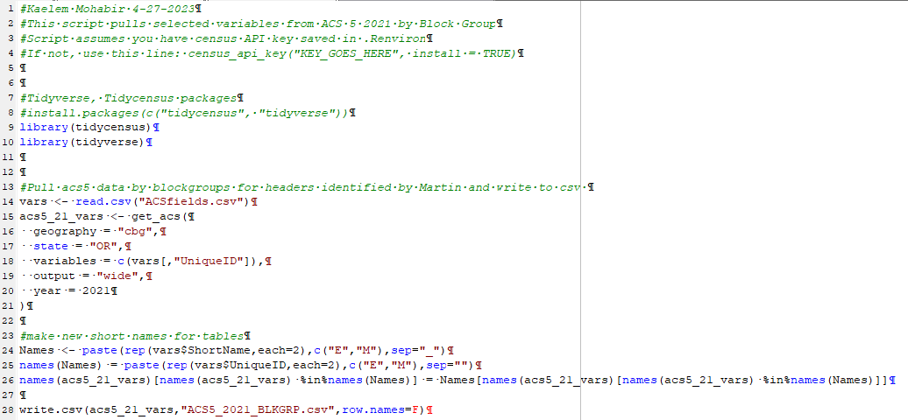
Selected ACS 5 Variables
Selected variables CSV (120)
Script to pull data for selected variables
Notes:
On the left are the 120 variables chosen to pull data for in a CSV with assigned shortnames
On the right is a script to pull the data for the selected variables
Same general process as for the decennial, with a couple of differences
Here we’re pulling by the block group (census block group or cbg) which is the smallest geography offered for the ACS
Lines 24-25 deal with Margin of Error (M) and Estimate € – ACS is based on a 5% survey and extrapolated for the full population
So they include the estimate and the margin of error for that estimate.

Slide 20
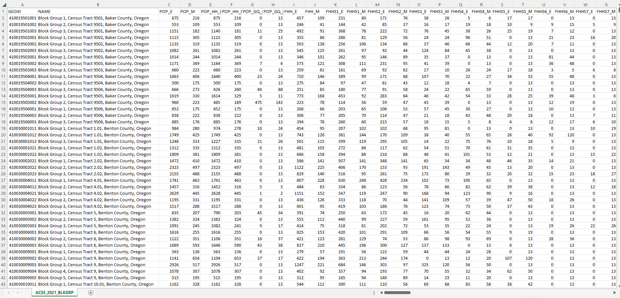
Selected ACS 5 Data
ACS 5 2021 Block Group Data (2,971 Rows)
Notes:
Here is the ACS5 output CSV with our selected variables and their new short names
By block group, each row represents a block group
MOE and E

Slide 21
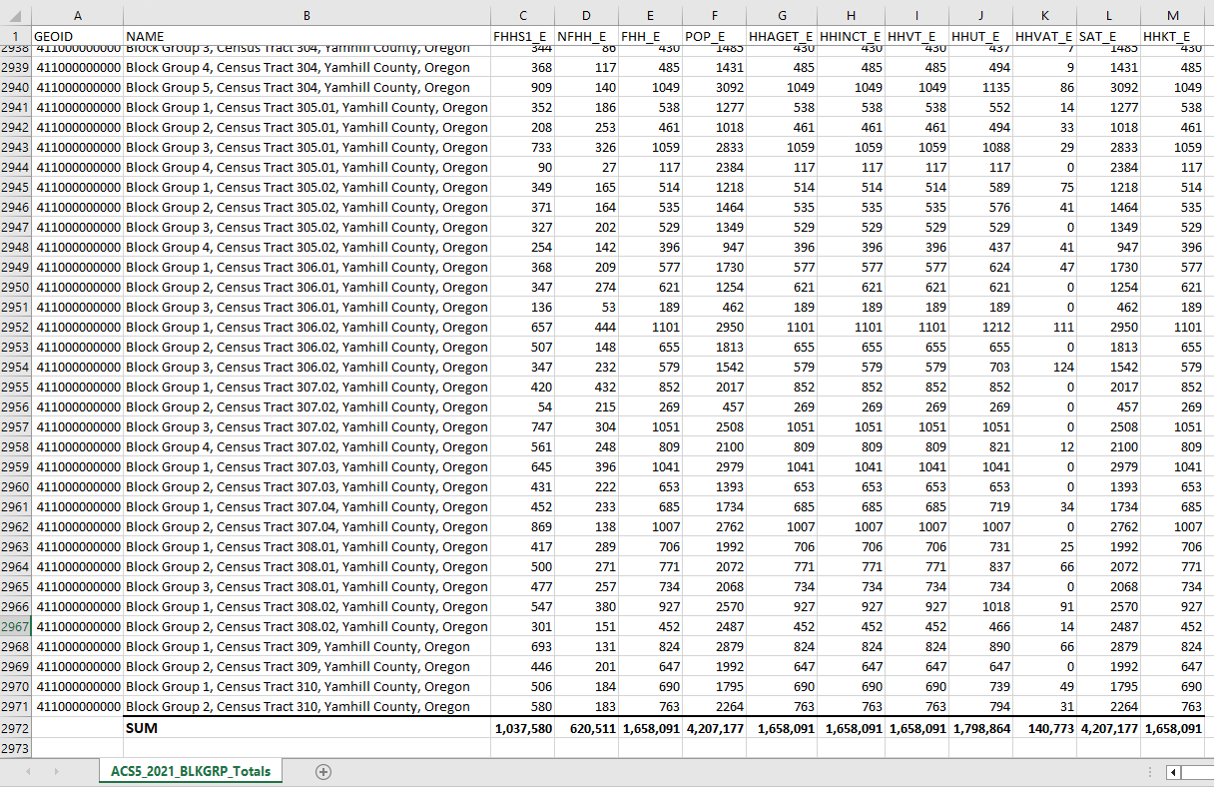
Field Totals
Tables do not all sum to the same totals
The sum of each table is dependent on what the table counts
Notes:
This slide shows the isolated ACS5 Blockgroup tables total variables
We looked at the different tables which had different universes a few slides back
So basically this means the different tables don’t all add up to the same total numbers
Theyre dependant on what each table is counting

Slide 22
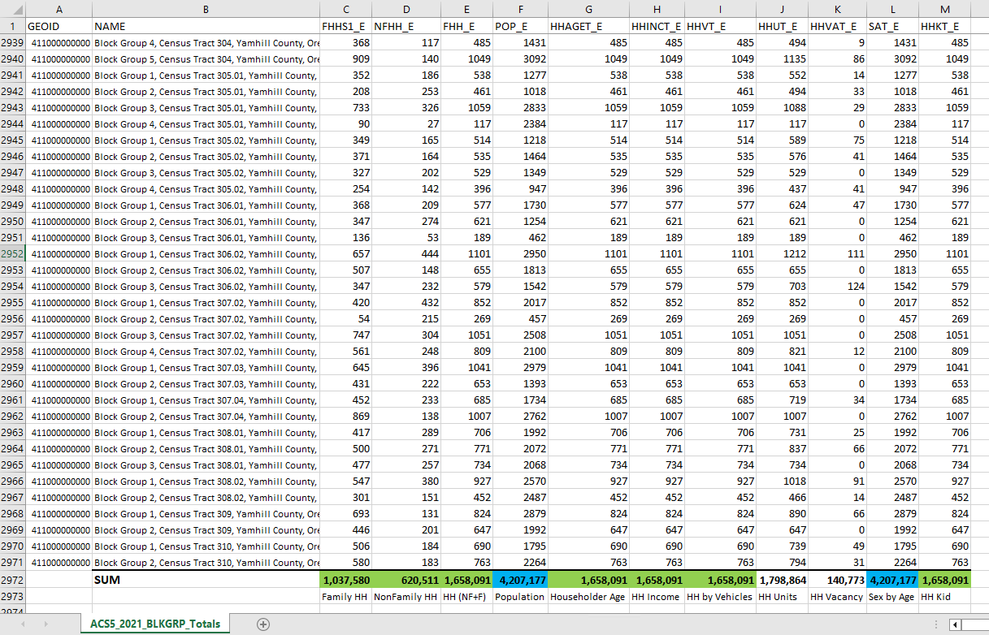
Field Totals
Green are total Households
Blue are total Population
HHUT – Housing type/units uses number of dwellings
Notes:
PopulationSim needs a common number of households and persons for every control.
You cannot feed different population numbers in and ask for total households.
We use these variables to build our controls so we have to process the input data to have the same sums
Add notes about field descriptions, why numbers are different.

Slide 23
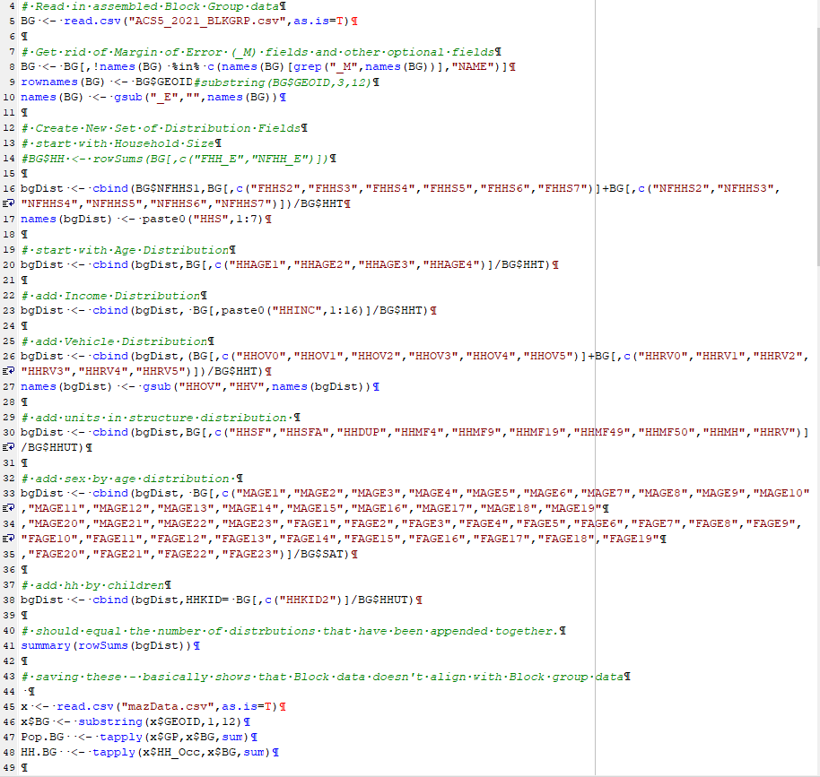
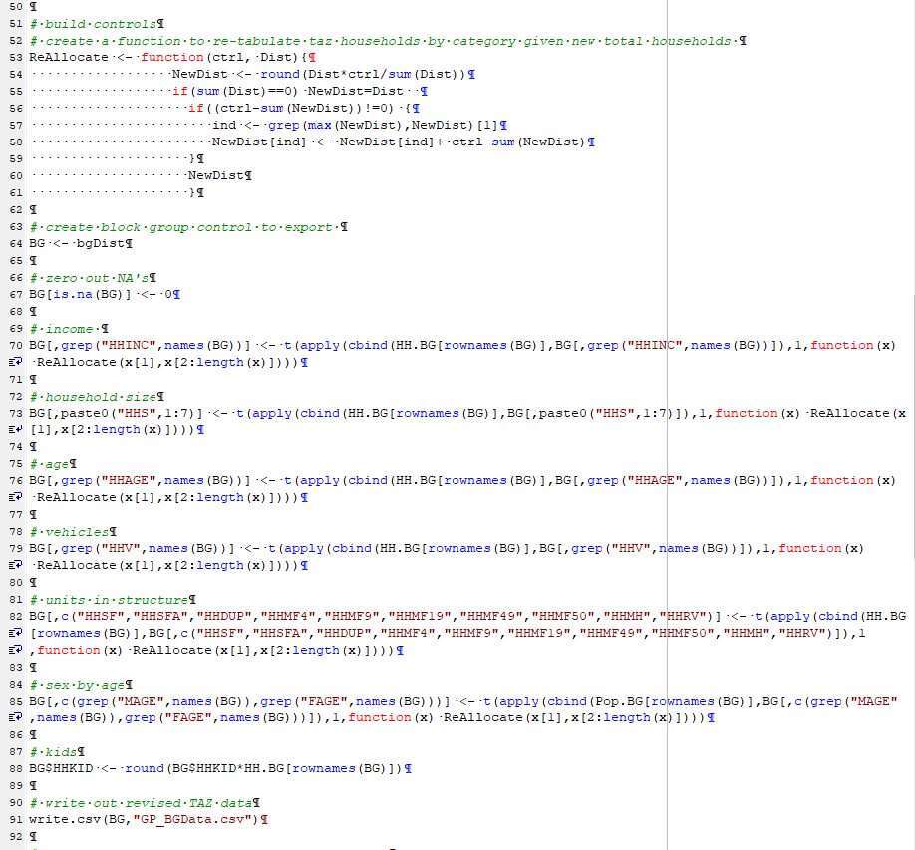
Balancing Input Data
Notes:
All fields must sum to the same total. This script redistributes them to have the same totals. Additionally, all the data must be intergerized. This script reproportions them to the correct total value, and deals with any rounding errors by rounding everything to an integer and then adding or subtracting a value as needed from the largest category in a group, if it does not perfectly match the total. This take place with the ReAllocate function on lines 53-61
on the left we are changing actual values to percentages. For each grouping of fields converting them into percentages instead of numbers, and then prepping to make everything sum to the same total
On the right side theres the reallocate function, cleaning up rounding errors and the integerization, [dealing with rounding errors]
And so this script reads in the raw ACS5 Block Group data, processes it to sum to the same totals, and produces GP_BGData.csv which is the final input for the General Population Block Group.

Slide 24
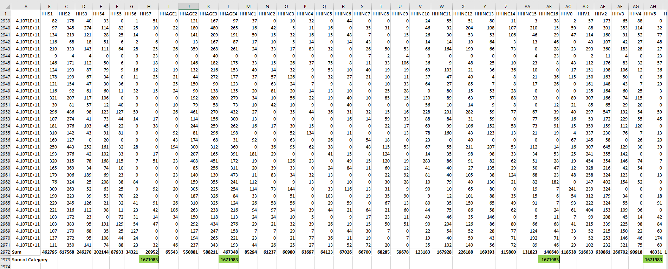
Balancing Input Data
Notes:
This is the output csv. In the green highlights we have the new congruent totals of the categories.

Slide 25
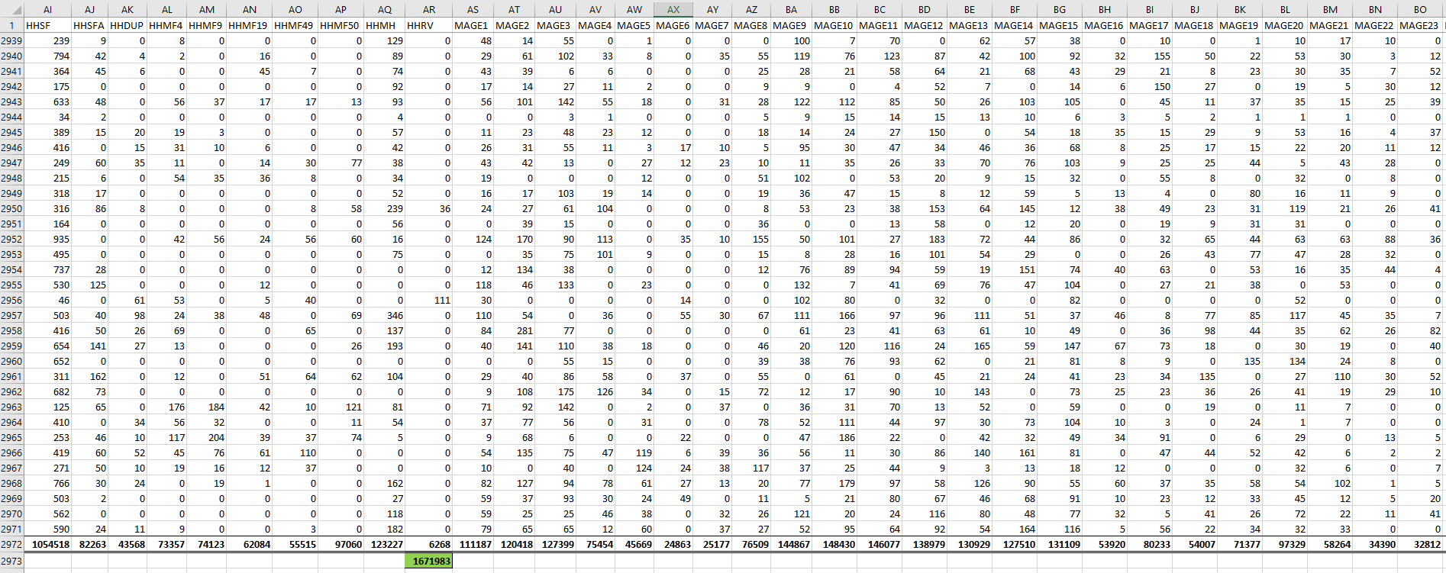
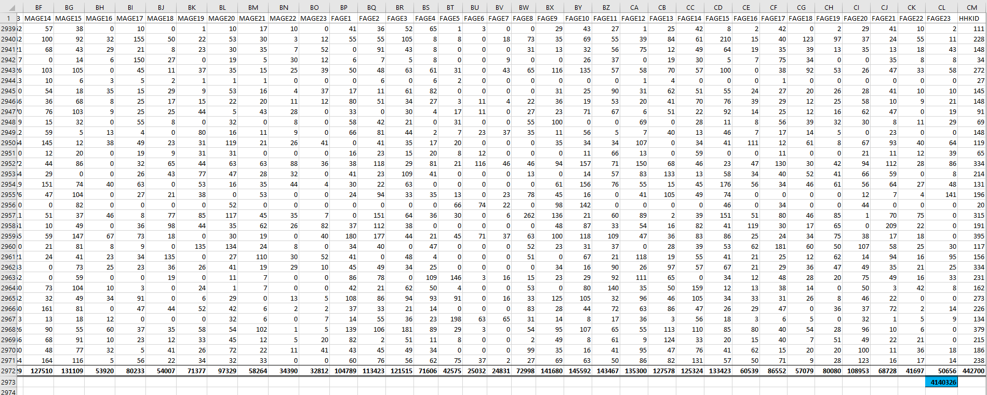
Balancing Input Data
Notes:
Here is the rest of the spreadsheet. The green sums are for total households and the blue is for total population.

Slide 26
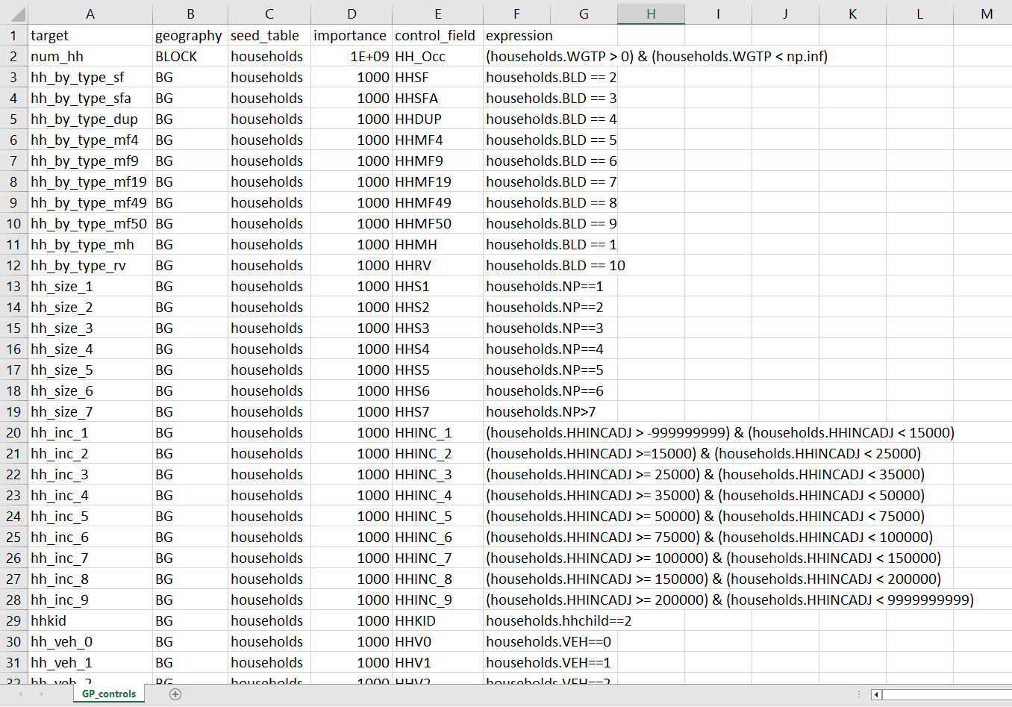
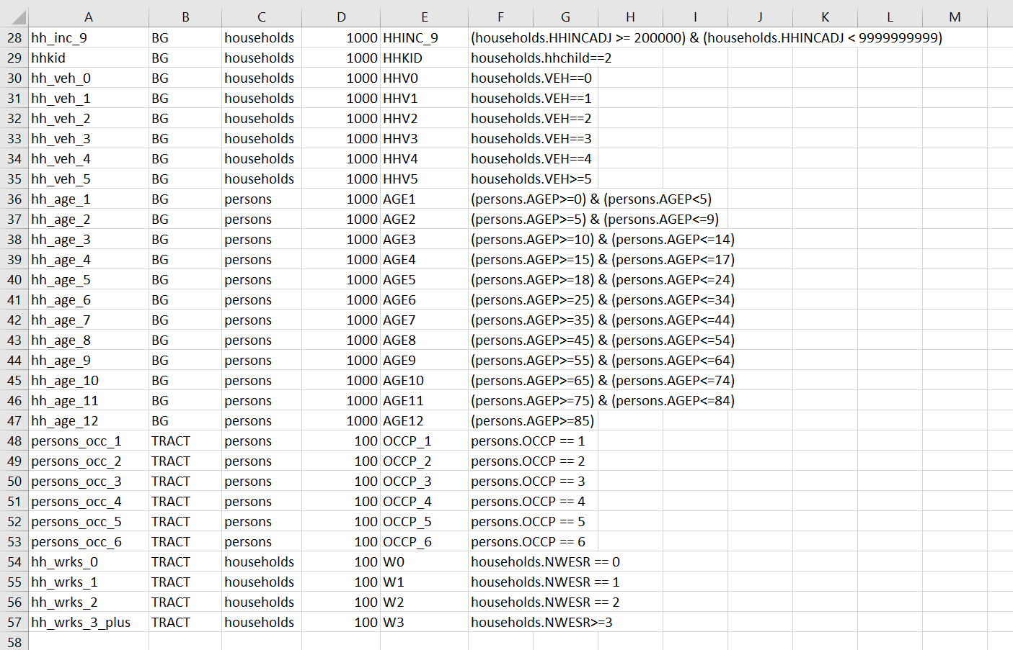
Controls
Notes:
The controls are built around the variables we pulled out from the census data and tell PopulationSim what to try and ensure is correctly represented in the output synthetic population.
There’s an importance field that allows for different levels of emphasis on different control fields.
Here households has by far the highest importance because we want that to be the most accurately represented

Slide 27
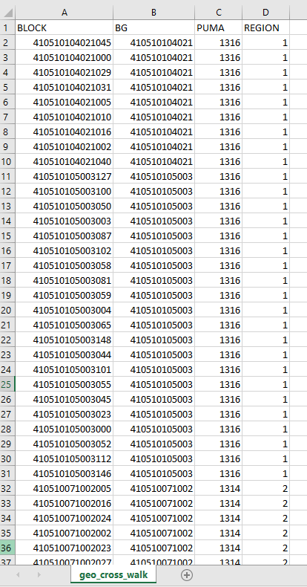
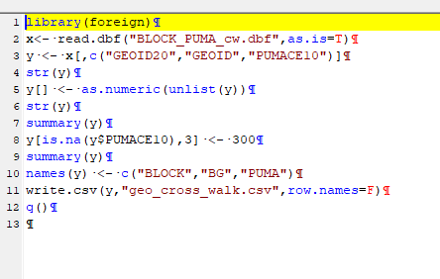
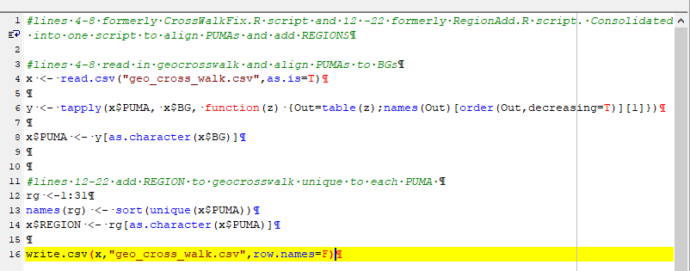
Geography Crosswalk
Notes:
The geographies must nest exactly into each other.
Region is arbitrary – needed for PopulationSim and has to be unique to 31 PUMAs but does not represent anything.
These two scripts create the crosswalk file we see to the far right.
The first script creates the file with the Block, BG, and PUMA geographies
The second script aligns the PUMAs to BGs (they didn’t match because we used 2010 PUMAs)
And adds unique regions to the geocrosswalk

Slide 28
Questions
Notes:
Here is the ACS5 output CSV with our selected variables and their new short names
By block group
MOE and E

